Slide 1
PowerShell

Slide 2

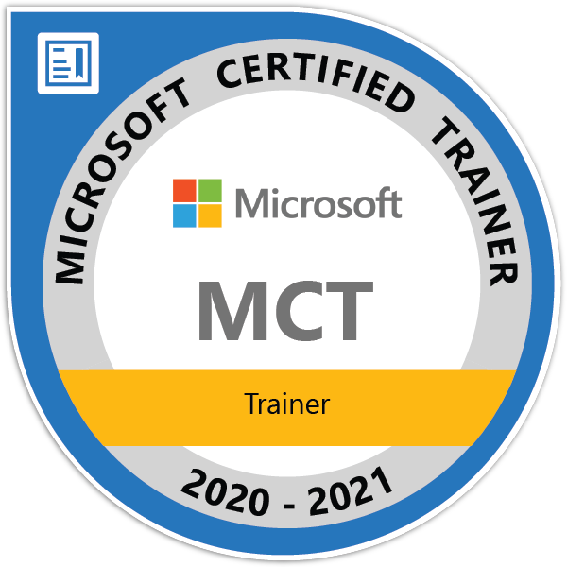
Hello!
Ercan ESE
Team Lead, Microsoft Certified Trainer
PowerShell, SCCM, Orchestrator, Azure, AD, Exchange

Slide 3
About this Course: Course Outline
M01: PowerShell About
M02: Cmdlet Administration
M03: Variables, Arrays
M04 :PowerShell Objects
M05: PowerShell If,Foreach,Switch,For Loops and Conditions

Slide 4
What is PowerShell?
PowerShell is a cross-platform task automation and configuration management framework, consisting of a command-line shell and scripting language.
Unlike most shells, which accept and return text, PowerShell is built on top of the .NET Common Language Runtime (CLR), and accepts and returns .NET objects.
This fundamental change brings entirely new tools and methods for automation.

Slide 5
PowerShell About
PowerShell Core is the new, open-sourced version of PowerShell that offers support for managing Linux, macOS, and Windows clients.
PowerShell now comes in two flavors: PowerShell (5.1) and PowerShell Core (6.0).
.NET Framework is the dependency for PowerShell for Windows-only support, while PowerShell Core is dependent on .NET Core runtime for cross-platform support.
Organizations transitioning to PowerShell Core should be aware of modules and cmdlets not being available initially due to foundational differences in the code.
PowerShell 5.1 will only receive stability updates, as needed, to fix critical bugs. PowerShell Core 6.0 will have on-going development, including new features moving forward.

Slide 6
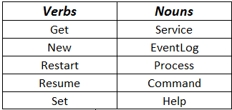
Cmdlet Administrations

Slide 7
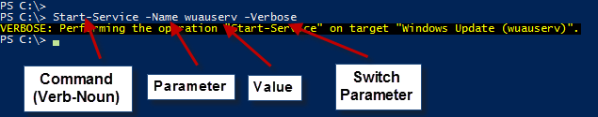
Cmdlet Administrations

Slide 8
Variables
You can store all types of values in PowerShell variables. For example, store the results of commands, and store elements that are used in commands and expressions, such as names, paths, settings, and values.
A variable is a unit of memory in which values are stored. In PowerShell, variables are represented by text strings that begin with a dollar sign ($), such as $a, $process, or $my_var.
$Name = "Ercan ESE"

Slide 9
Arrays
Dizi bir öğe koleksiyonunu depolamak için tasarlanan bir veri yapısıdır. Öğeler aynı türde veya farklı türlerde olabilir.
Windows PowerShell 3,0 ' den başlayarak, sıfır veya bir nesne koleksiyonunun bazı dizi özellikleri vardır.
$IntArray = 1,2,3,4
$StringArray = "Dünya","Mars","Venüs"

Slide 10
PowerShell Object Cmdlets
Select-Object
Where-Object
Sort-Object
Measure-Object
Get-Service | Select-Object -Property Name
Get-Service | Where-Object Status -eq "Running"
Get-Service | Sort-Object -Property Name
Get-Service | Measure-Object

Slide 11
If Foreach
$Size = 10GB
if($Size -le 5GB )
{
"This code"
}
else
{
"This code"
}
$Planets = "Venüs","Dünya","Mars"
foreach($Planet in $Planets)
{
$Planet #do something
}

Slide 12
For Switch
for ($i = 1; $i -lt 99; $i++)
{
$i
}
switch ("Dünya")
{
'Dünya' { #equal earth do something }
'Mars' {}
'Venüs' {}
}

Slide 13

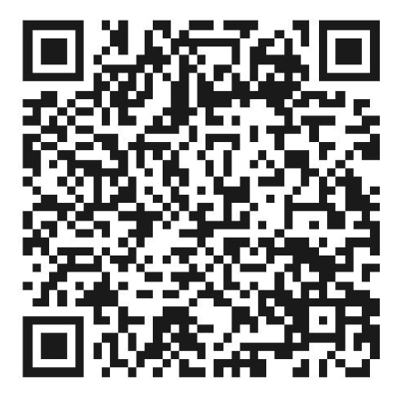
Thanks.
http://ercanese.com/
ercan.ese@hotmail.com

